Slide 1

Simulation of Trading in an artificial Stock Market
Nicholas Eyring Youri Popoff

Slide 2
Contents
The Big Picture
Description of the Model
Results
Implementation
Our Experience

Slide 3
The Big Picture – Why do we want a Model
The financial system is flawed
A financial crisis has very broad repercussions on the general prosperity of the population
The stock market can be used as a general indicator of the state of an economy
The goal : to foresee/prevent financially unfavorable situations by modelling trading on the stock market
Stock Market
Investor Confidence
Individual Corporations
Economy as a Whole

Slide 4
Fundamental Research Questions
How does past market volatility affect the future price of a stock
To what extent can price regulation be used to stabilize a volatile market
How accurately can financially unfavorable situations be modelled

Slide 5
The Model (1)
One publically traded firm
Based on paper (Raberto, 2005)
Agent-based simulation : Traders (agents) interact in the market (playground)
Fixed number of traders each of which have a specific amount of shares and liquidities which evolve over time
Limit order book (double auction) mechanism : sellers and buyers bid seperately; price overlap of bids causes a transaction
Seller Bids
Buyer Bids

Slide 6
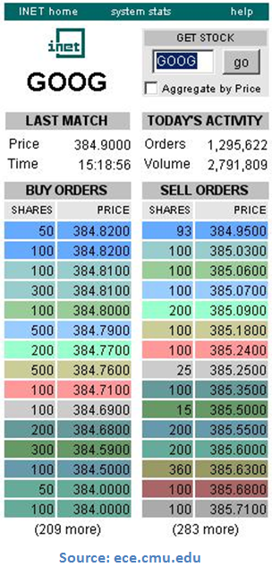
The Model (2)
Time is separated into days
At the end of a day the market closes : all remaining bids are cleared from the books
Input : initial bid prices (IPO parameters), number of traders, distribution parameters for random variables, etc...
Output : Average transaction price over time, trader assets over time, value of firm over time, etc...

Slide 7
Sequence of Events – When the market is open
Choose Trader
Trader Places Buy or Sell Bid
Execute Transaction if necessary
Wait
The waiting time follows an exponential distribution
A trader is chosen based on a uniform distribution
The trader will place either a buy or sell order with a predetermined probability
The price of the order follows a Gaussian distribution with the price of the most competitive valid order as the mean
The number of shares ordered is uniformly distributed between 1 and the trader’s maximum

Slide 8
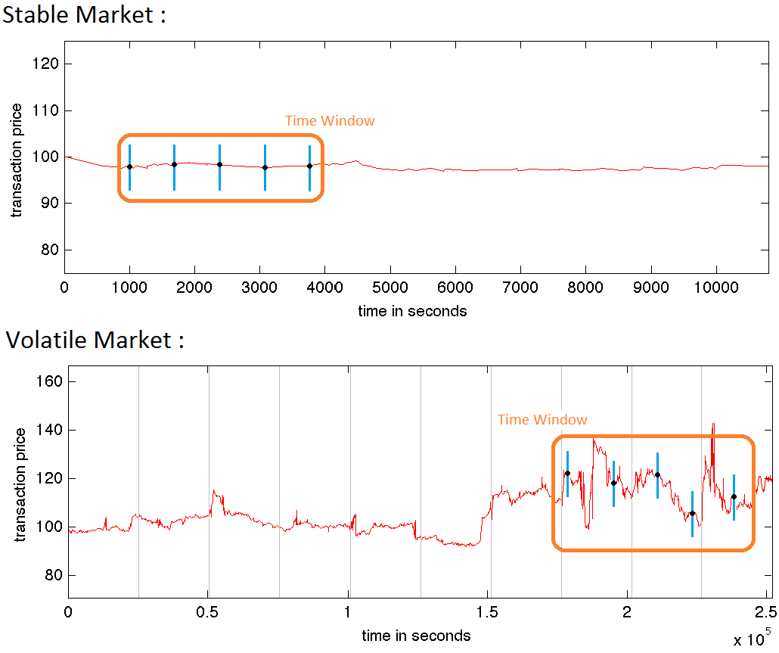
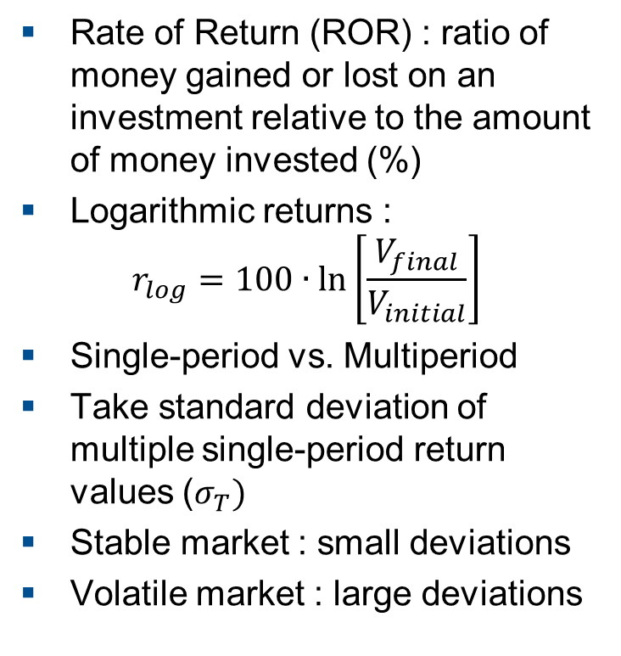
Measuring Market Volatility
Rate of Return (ROR) : ratio of money gained or lost on an investment relative to the amount of money invested (%)
Logarithmic returns :
$$r_{log}=100∙\ln\left[\frac{V_{final}}{V_{initial}}\right]$$
Single-period vs. Multiperiod
Take standard deviation of multiple single-period return values ($σ_{T})$
Stable market : small deviations
Volatile market : large deviations

Slide 9
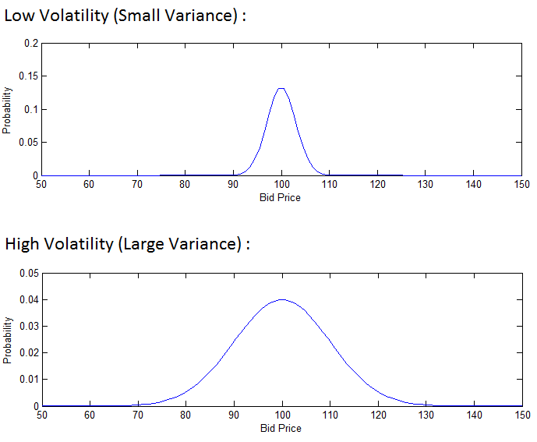
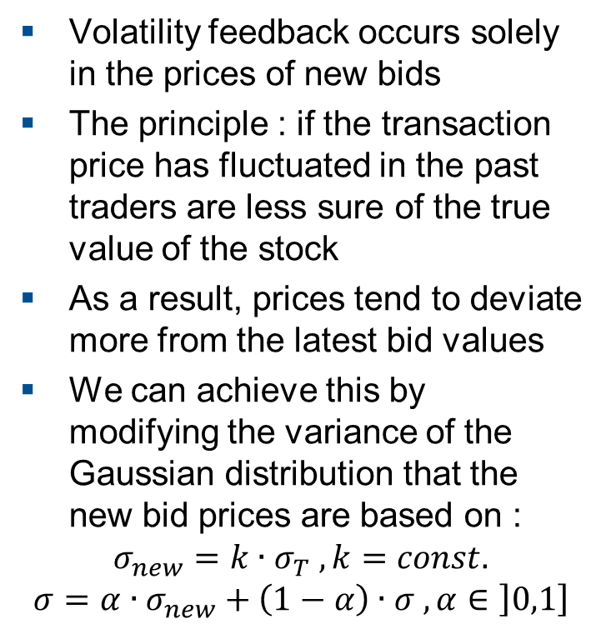
Taking past Market Volatility into Account
Volatility feedback occurs solely in the prices of new bids
The principle : if the transaction price has fluctuated in the past traders are less sure of the true value of the stock
As a result, prices tend to deviate more from the latest bid values
We can achieve this by modifying the variance of the Gaussian distribution that the new bid prices are based on :
$$σ_{new}=k∙σ_{T} , k=const.$$
$$σ=α∙σ_{new}+\left(1−α\right)∙σ , α∈\left]0,1\right]$$

Slide 10
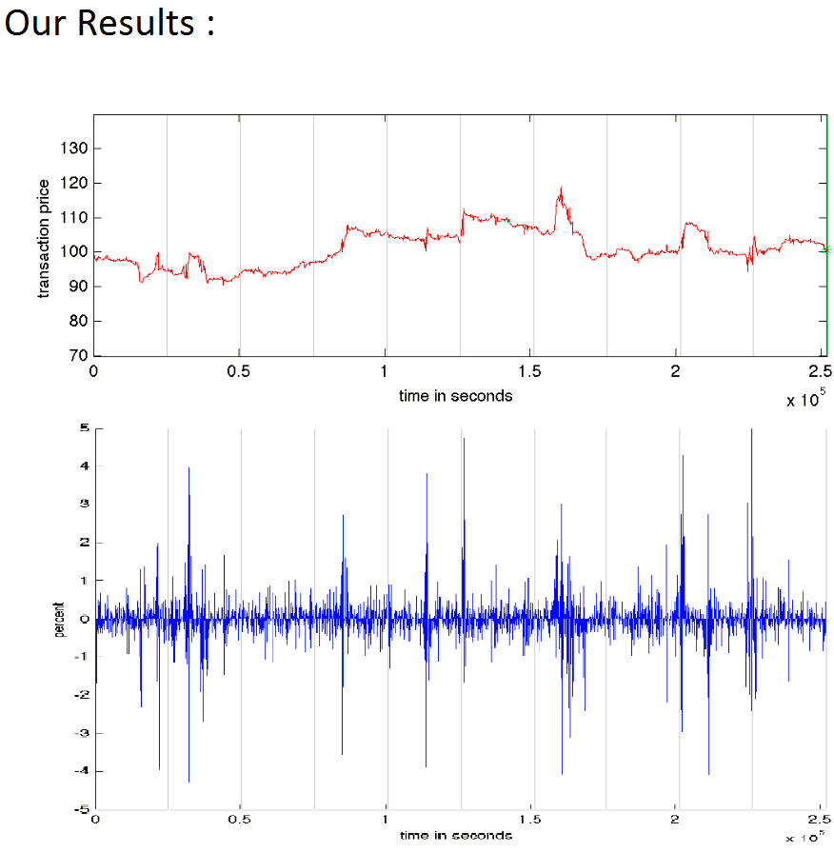
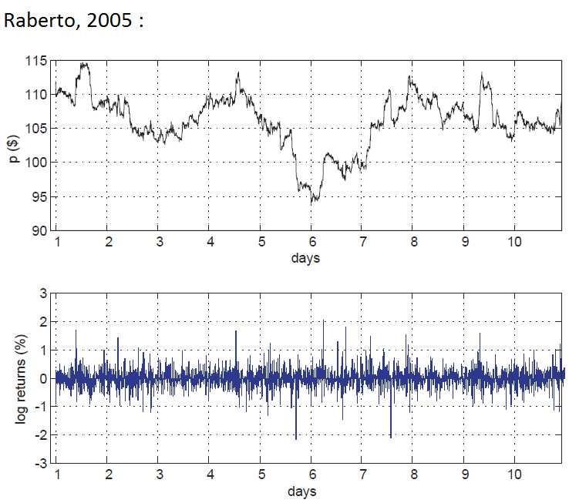
Results – Without Volatility Feedback

Slide 11
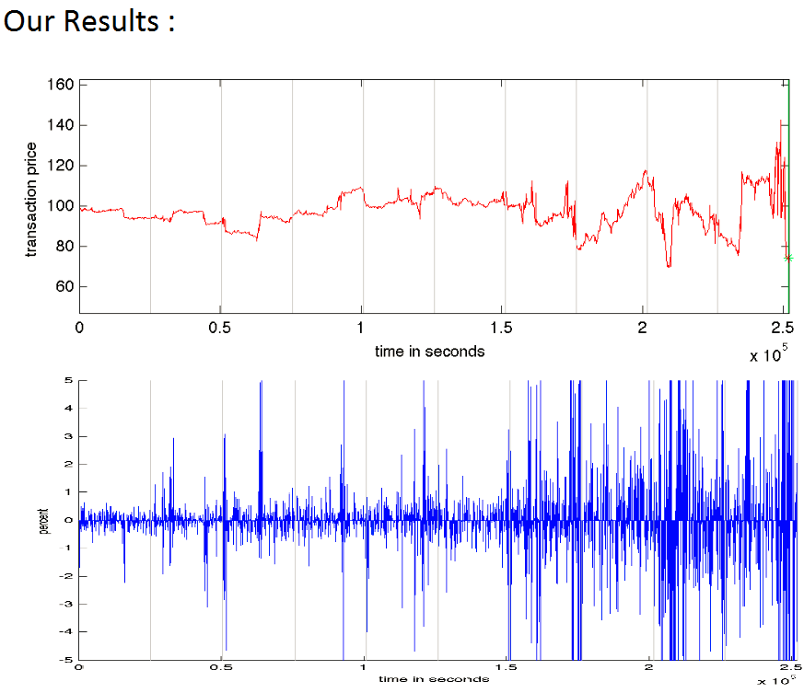
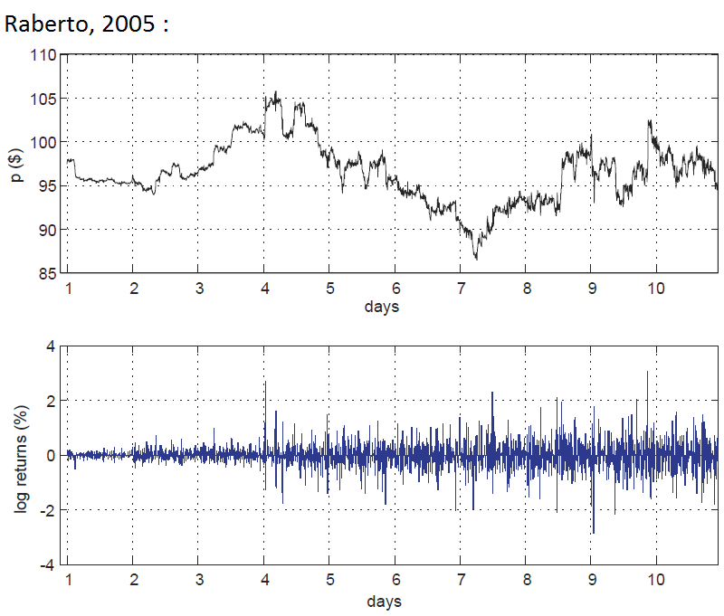
Results – With Volatility Feedback

Slide 12
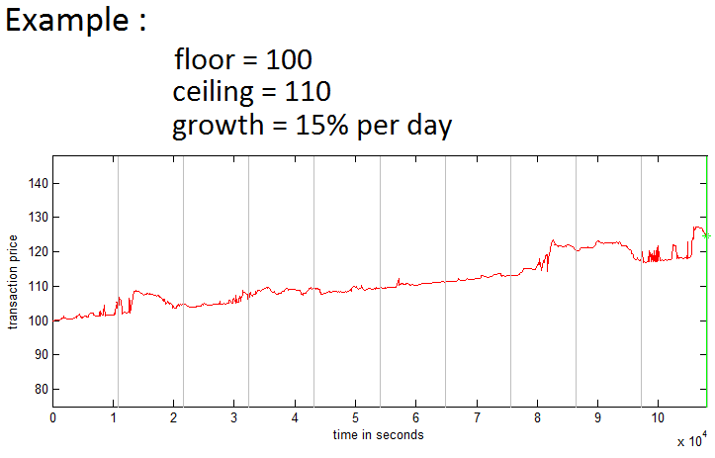

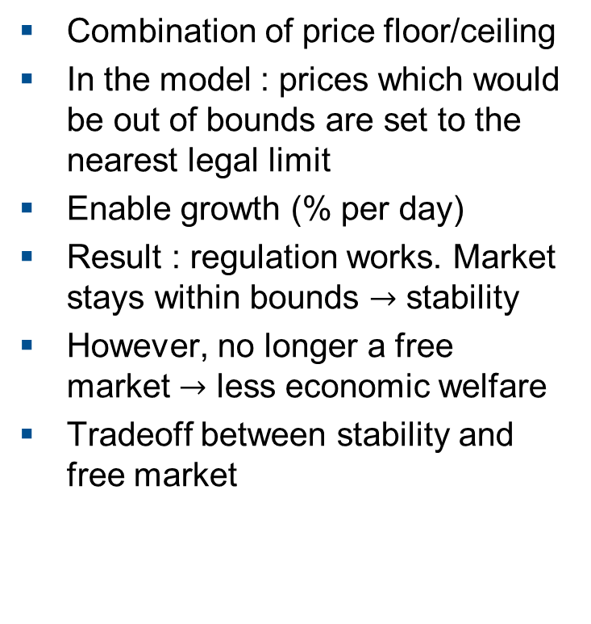
Using Price Regulation to stabilize the Market
Combination of price floor/ceiling
In the model : prices which would be out of bounds are set to the nearest legal limit
Enable growth (% per day)
Result : regulation works. Market stays within bounds $→$ stability
However, no longer a free market $→$ less economic welfare
Tradeoff between stability and free market
$$\left\{\begin{aligned}p_{c}\left(t\right)=p_{c0}+ \frac{g∙p_{c0}}{24∙60∙60}∙t \\ p_{f}\left(t\right)=p_{f0}+ \frac{g∙p_{f0}}{24∙60∙60}∙t \end{aligned}\right.$$
With g = growth ( % per day )

Slide 13
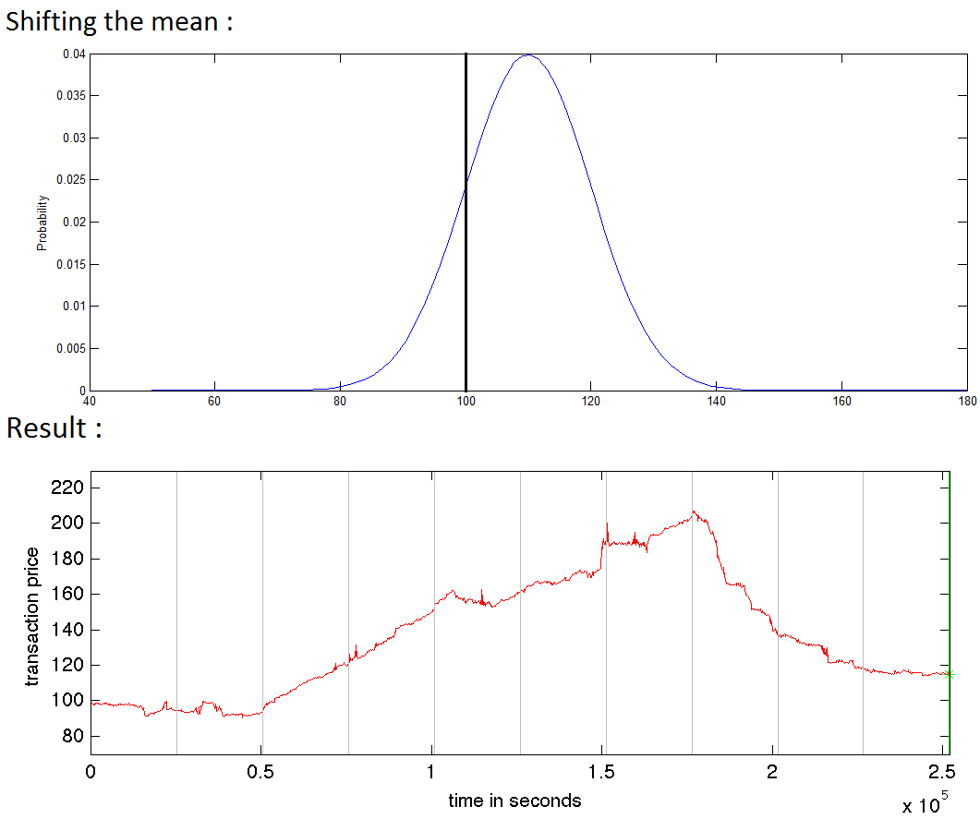
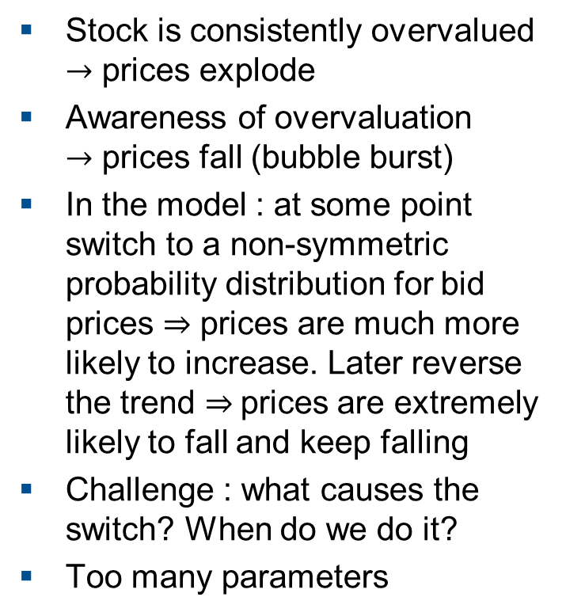
Modelling Financial Bubbles
Stock is consistently overvalued $→$ prices explode
Awareness of overvaluation $→$ prices fall (bubble burst)
In the model : at some point switch to a non-symmetric probability distribution for bid prices $⇒$ prices are much more likely to increase. Later reverse the trend $⇒$prices are extremely likely to fall and keep falling
Challenge : what causes the switch? When do we do it?
Too many parameters

Slide 14
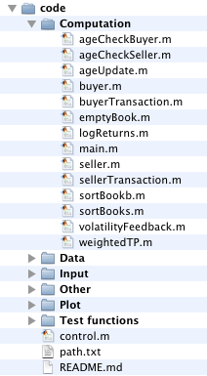
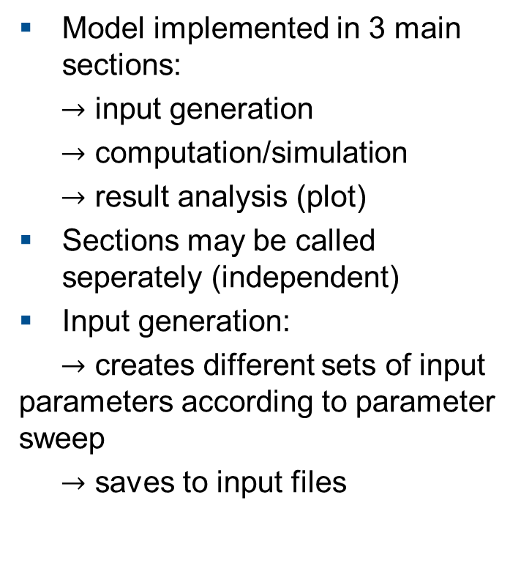
Implementation (1)
Model implemented in 3 main sections:
$→$ input generation
$→$ computation/simulation
$→$ result analysis (plot)
Sections may be called seperately (independent)
Input generation:
$→$ creates different sets of input parameters according to parameter sweep
$→$ saves to input files

Slide 15
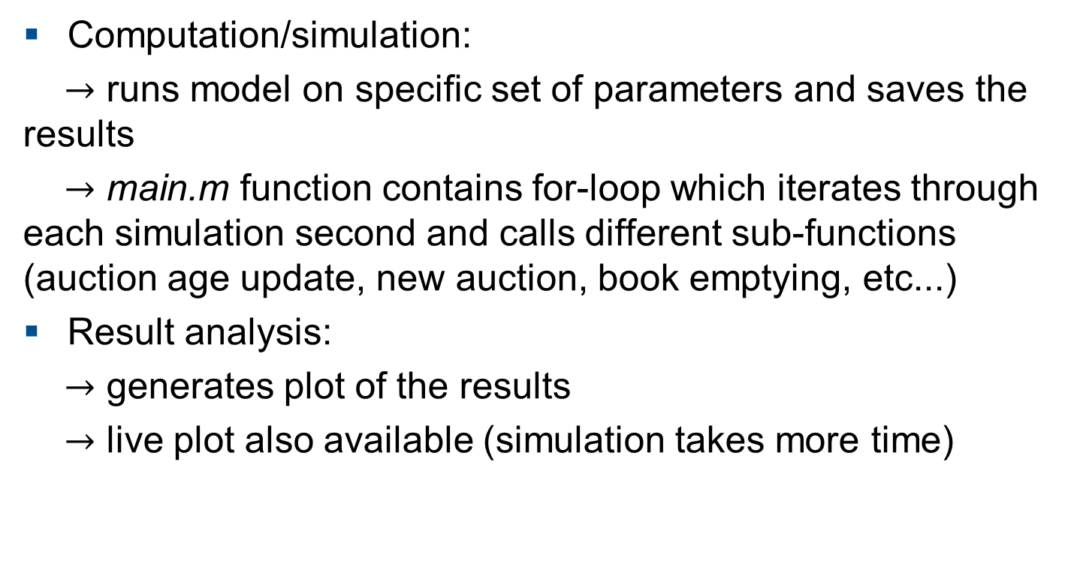
Implementation (2)
Computation/simulation:
$→$ runs model on specific set of parameters and saves the results
$→$ main.m function contains for-loop which iterates through each simulation second and calls different sub-functions (auction age update, new auction, book emptying, etc...)
Result analysis:
$→$ generates plot of the results
$→$ live plot also available (simulation takes more time)

Slide 16
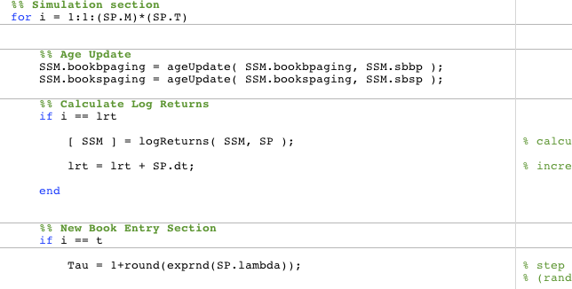
main.m (sample)

Slide 17

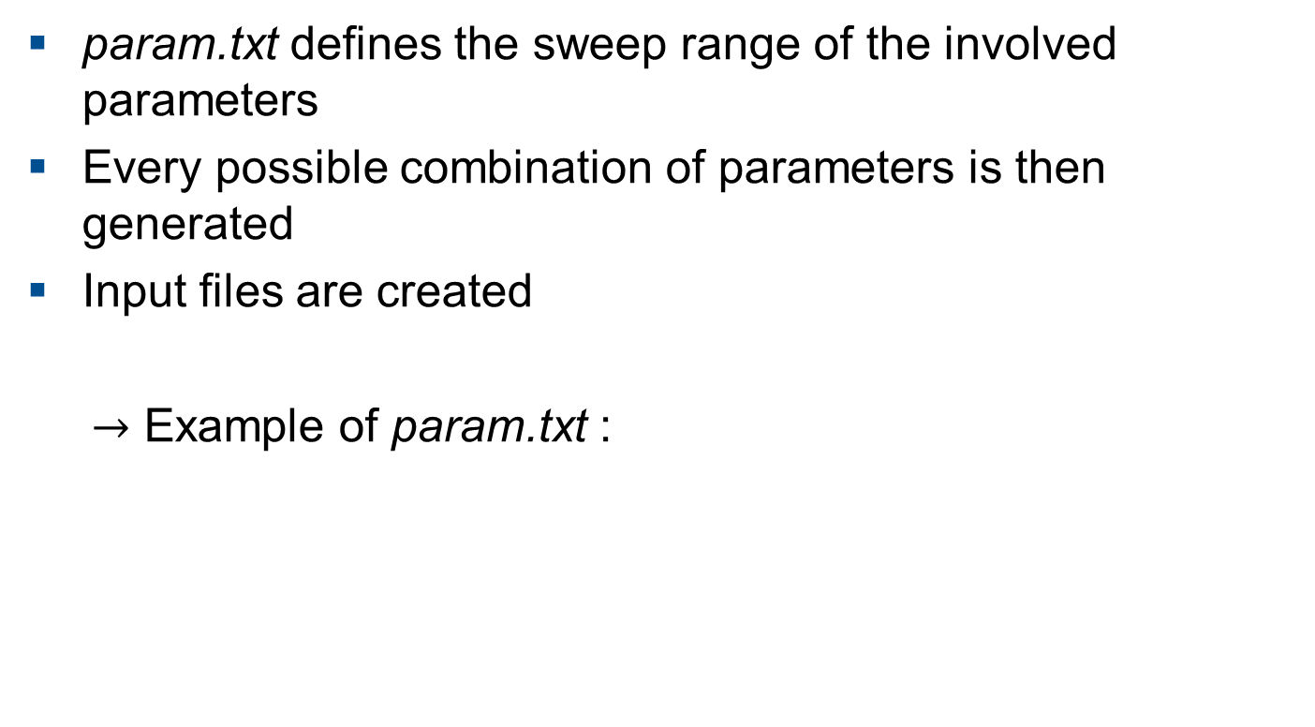
Parameter Sweep
param.txt defines the sweep range of the involved parameters
Every possible combination of parameters is then generated
Input files are created
$→$ Example of param.txt :

Slide 18
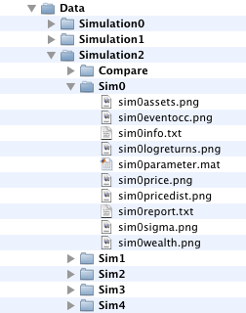
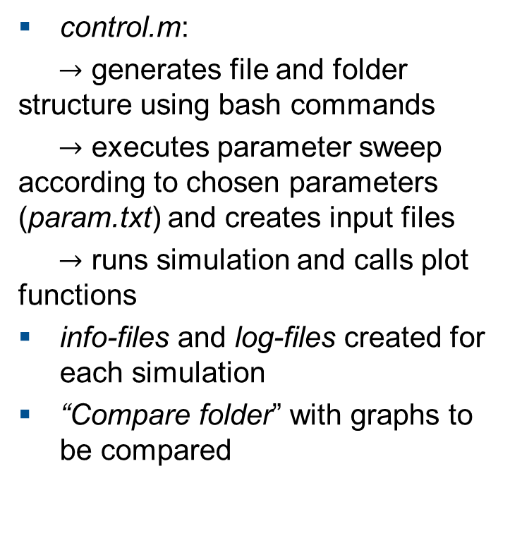
Automatic File Structure
control.m:
$→$ generates file and folder structure using bash commands
$→$ executes parameter sweep according to chosen parameters (param.txt) and creates input files
$→$ runs simulation and calls plot functions
info-files and log-files created for each simulation
“Compare folder” with graphs to be compared

Slide 19
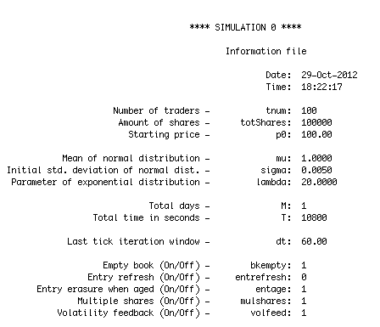
Information File (sim0info.txt)

Slide 20

Our Experience - Why we didn’t hand it in
Time management
$→$ debugging can be VERY time consuming!
$→$ eg. $\sim$12h : parameter is too big by a factor of 100

Slide 21
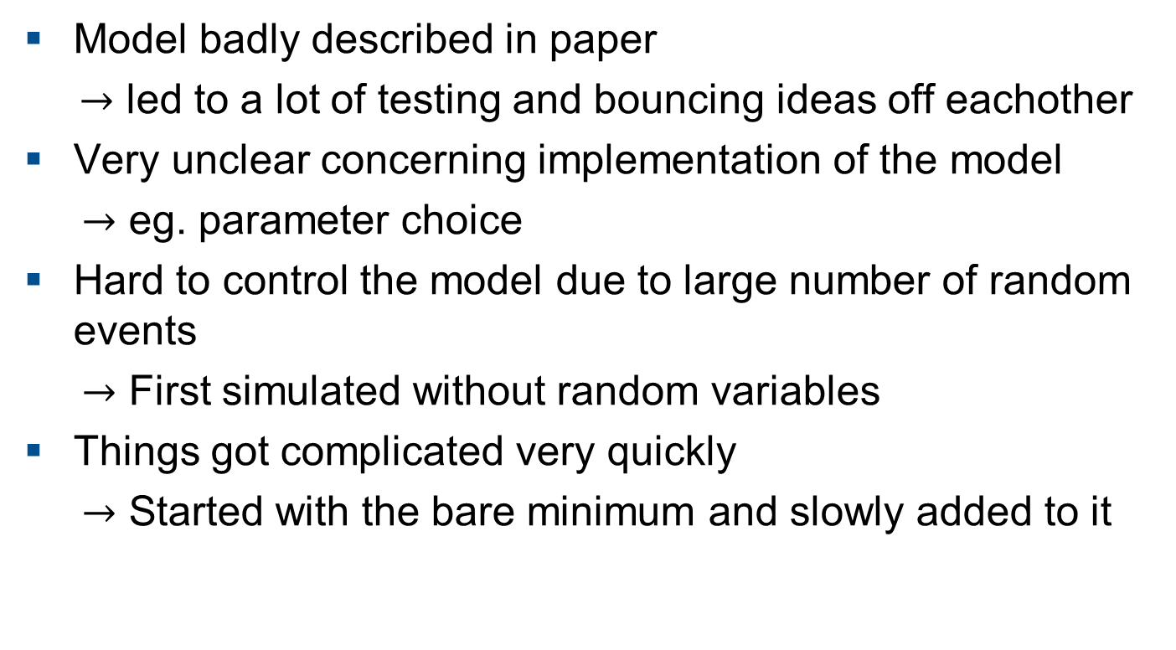
Problems we had to overcome
Model badly described in paper
$→$ led to a lot of testing and bouncing ideas off eachother
Very unclear concerning implementation of the model
$→$ eg. parameter choice
Hard to control the model due to large number of random events
$→$ First simulated without random variables
Things got complicated very quickly
$→$ Started with the bare minimum and slowly added to it

Slide 22
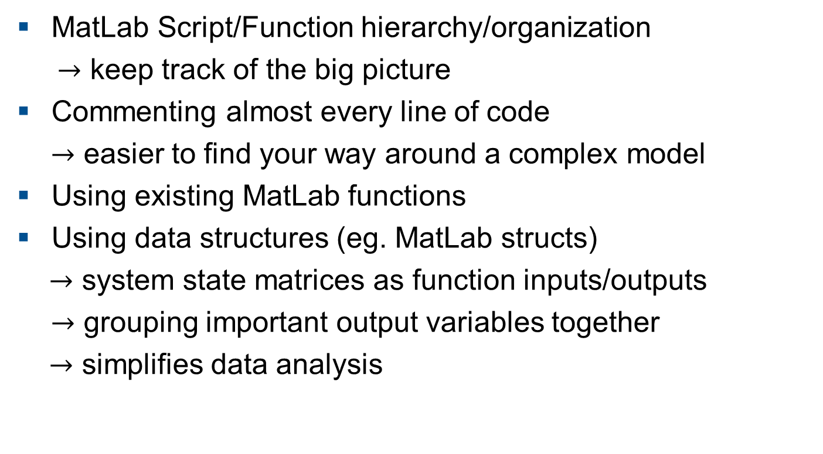
Things we did well
MatLab Script/Function hierarchy/organization
$→$ keep track of the big picture
Commenting almost every line of code
$→$ easier to find your way around a complex model
Using existing MatLab functions
Using data structures (eg. MatLab structs)
$→$ system state matrices as function inputs/outputs
$→$ grouping important output variables together
$→$ simplifies data analysis

Slide 23
Thanks for listening!

